Slide 1
Parallel K-means Clustering using CUDA
Lan Liu
Pritha D N
12/06/2016

Slide 2
Outline
Performance Analysis
Overview of CUDA
Future Work

Slide 3
Review of Parallelization
Complexity of sequential K-Means algorithm: O(N*D*K*T)
N: # of datas.
D: # of dimension.
K: # of clusters.
T: # of iterations.
Complexity of each iteration step:
Part2: compute the new center as mean of new cluster datas. O((N+K)*D)--> O((2*delta+K)*D)
delta: #of membership change.
Part1: for each data point, compute the distance with K cluster centers and assign to the nearest one. O(N*D*K) Parallelize on CUDA (SIMD: single instruction multiple data)
Notes:
To compute new centers, previously we add all datas in the cluster together and average them, it costs N+K. Since only a small portion of data will change membership, as long as a data changes membership, we add it to the new cluster and remove it from the old one. This will enhance the efficiency of part2.

Slide 4
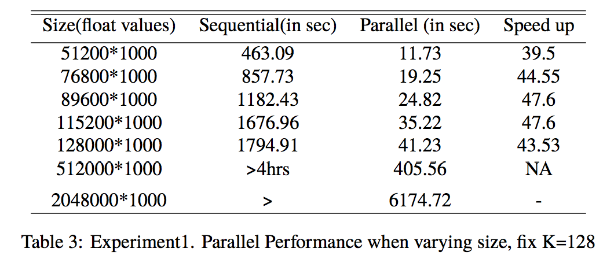
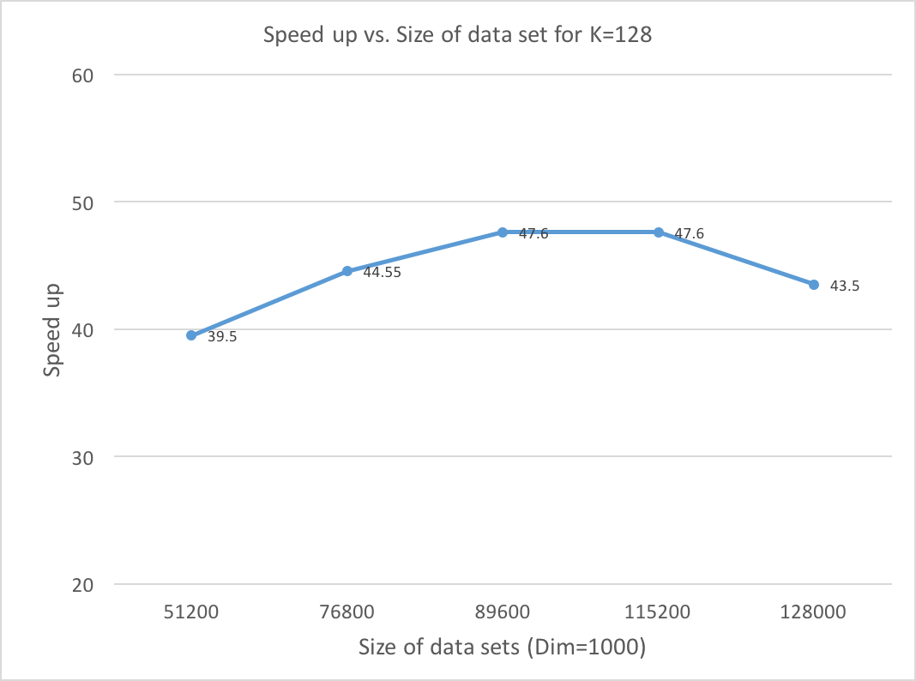
Performance Analysis
Experiment1: set K=128, D=1000, changing size N.
Notes:
The capacity of GPU on comet is 11gb. And we tested for 8gb of data was the max we tried, 1.7hour, 3 days. CUDA code outperforms sequential code a lot.

Slide 5
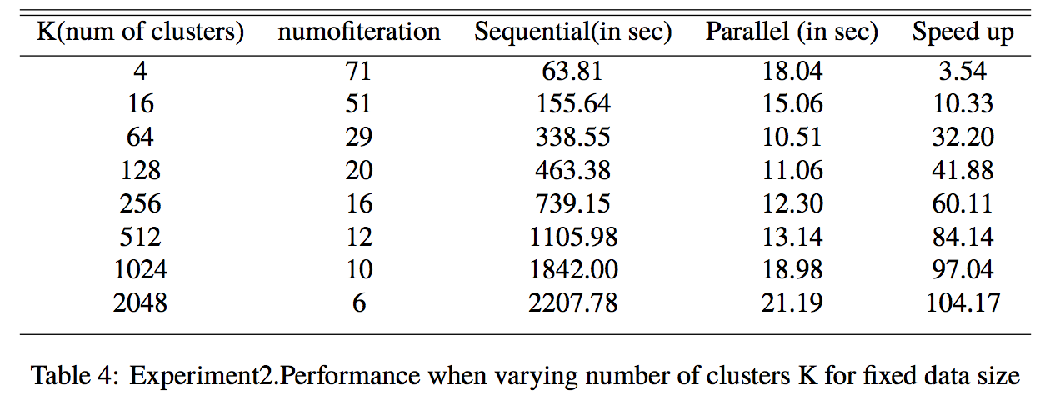
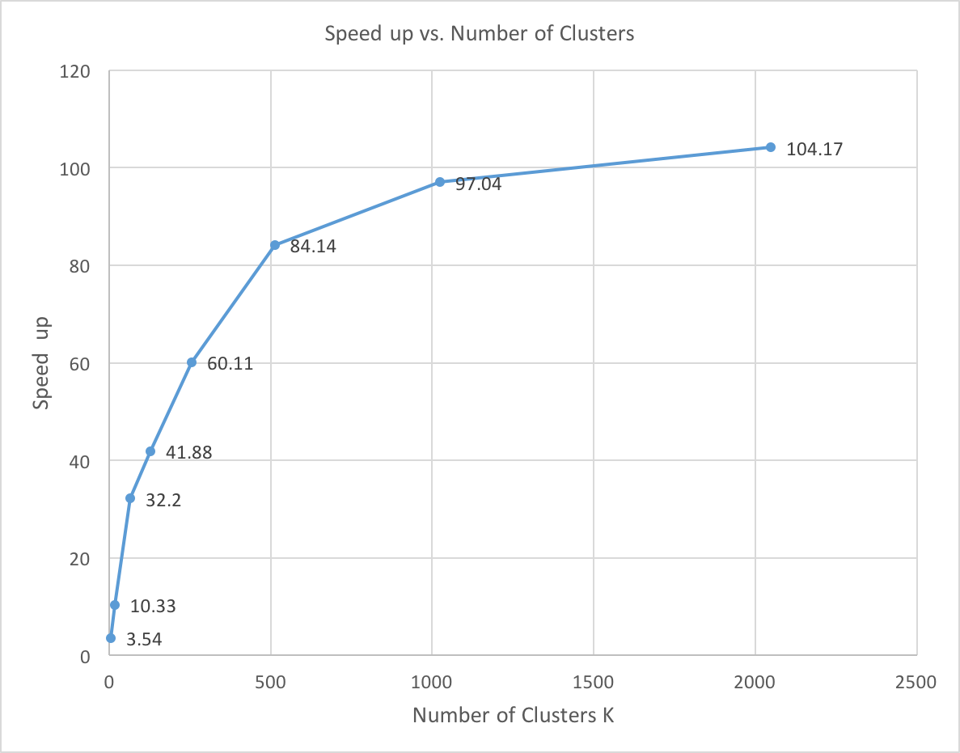

Performance Analysis
Experiment 2: set N=51200, D=1000, changing number of clusters K.
Speedup (N>>K, D>K)
Notes:
If keep N the same, increase K. what will happen?
Each data has been assigned more work to do.

Slide 6
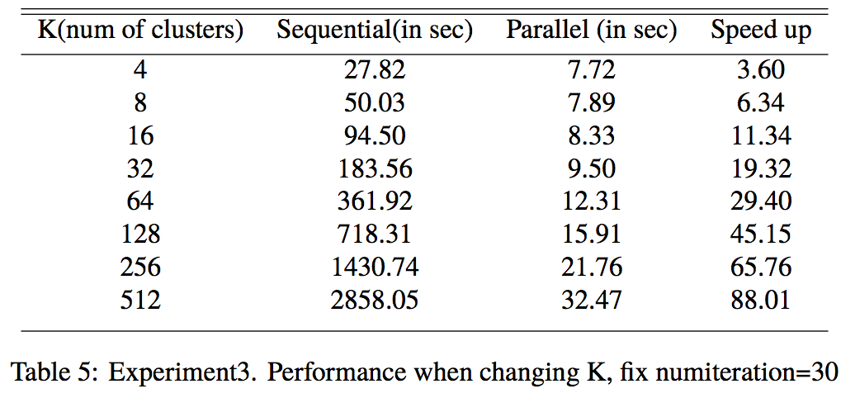
Performance Analysis
Experiment 3: set N=51200, D=1000, T=30. changing number of clusters K.

Slide 7
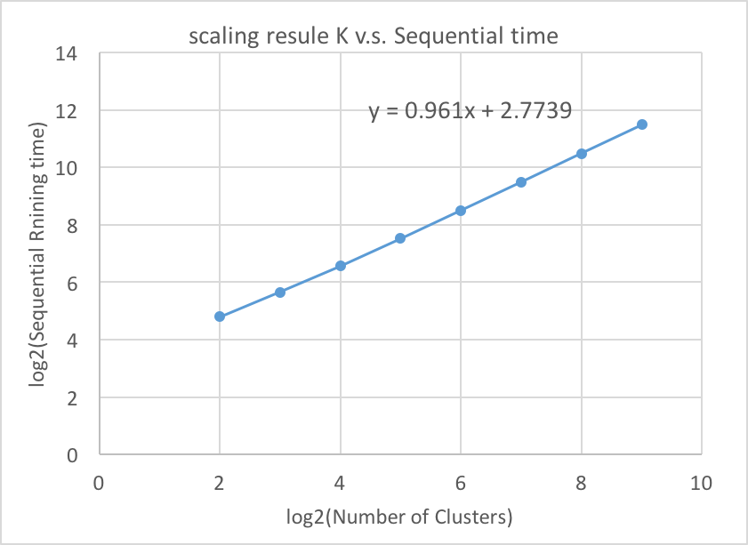
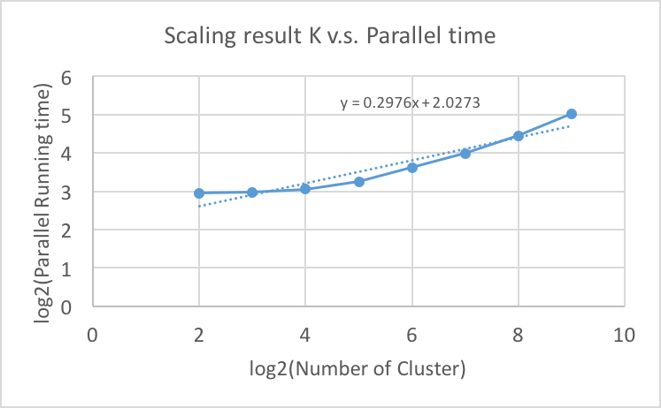
Performance Analysis
Experiment 3 continue..
Slope~1, K double, running time double

Slide 8
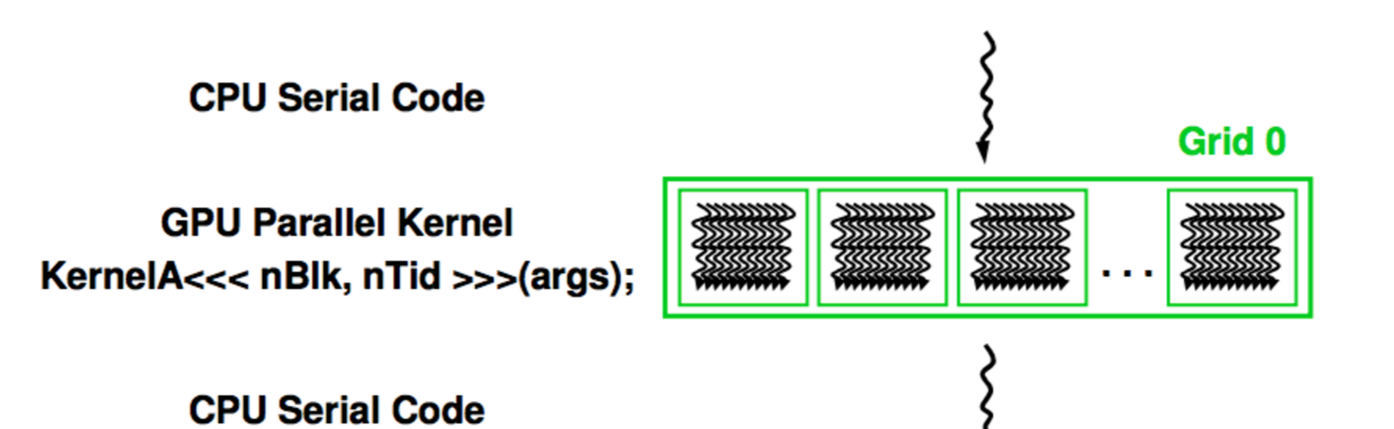
CUDA - Execution of a CUDA program
find_nearest_cluster

Slide 9
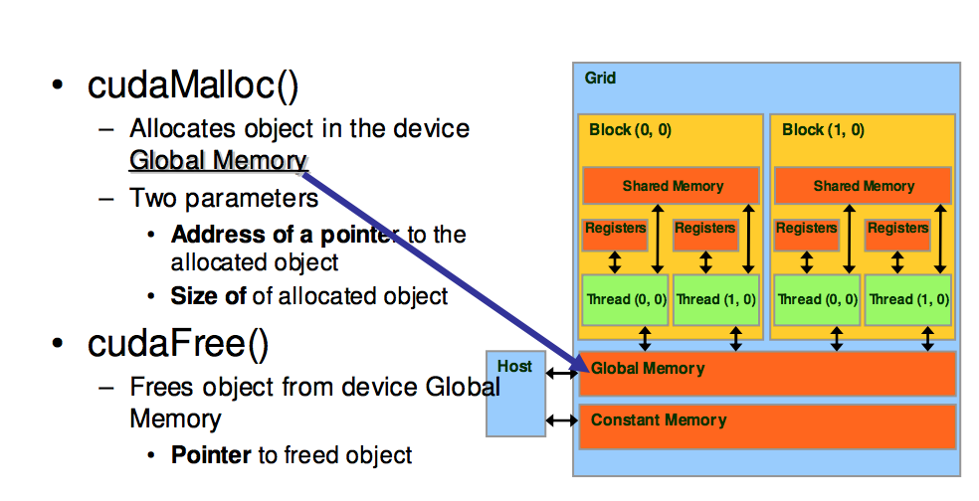
CUDA - Memory Organisation

Slide 10
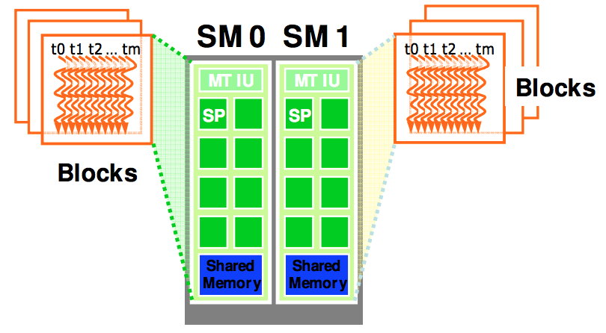
CUDA - Thread Organization
Execution resources are organized into Streaming Multiprocessors(SM).
Blocks are assigned to Streaming Multiprocessors in arbitrary order.
Blocks are further partitioned into warps.
SM executes only one of its resident warps at a time.
The goal is to keep an SM max occupied.
Threads per Warp | 32
Max Warps per Multiprocessor | 64
Max Thread Blocks per Multiprocessor | 16
Notes:
GPU on Comet has Compute Capacity of 3.7.
Max 2048 threads per SM.
Once a grid is launched, its blocks are assigned to Streaming Multiprocessors in arbitrary order, resulting in transparent scalability of applications. The transparent scalability comes with a limitation: threads in different blocks cannot synchronize with each other. The only safe way for threads in different blocks to synchronize with each other is to terminate the kernel and start a new kernel for the activities after the synchronization point. Threads are assigned to SM for execution on a block-by-block basis. For X80 processors, each SM can accommodate up to 16 blocks or 2048 threads, which ever becomes a limitation first. Once a block is assigned to SM, it is further partitioned into warps. At any time, the SM executes only one of its resident warps.
If we use 64 threads per block then there are 2 warps but SM can have 4 warps - wasted.
128 threads = 128/32 = 4 warps; max blocks = 16; max warps = 64 => 64/16=4 warps per block
A legitimate question is why we need to have so many warps in an SM considering the fact that it executes only one of them at any point in time. The answer is that this is how these processors efficiently execute long latency operations such as access to the global memory. When an instruction executed by threads in a warp needs to wait for the result of a previously initiated long-latency operation, the warp is placed into a waiting area. One of the other resident warps who are no longer waiting for results is selected for execution. If more than one warp is ready for execution, a priority mechanism is used to select one for execution.

Slide 11
NVProf
N = 51200
Dimension = 1000
k = 128
Loop iterations = 21
Time(%) Time Calls Avg Min Max Name
98.99% 4.11982s 21 196.18ms 195.58ms 197.96ms find_nearest_cluster(int, int, int, float*, float*, int*, int*)
0.98% 40.635ms 23 1.7668ms 30.624us 39.102ms [CUDA memcpy HtoD]
0.03% 1.2578ms 42 29.946us 28.735us 31.104us [CUDA memcpy DtoH]
Time(%) Time Calls Avg Min Max Name
93.06% 4.12058s 21 196.22ms 195.62ms 198.00ms cudaDeviceSynchronize
5.79% 256.47ms 4 64.117ms 4.9510us 255.97ms cudaMalloc
1.02% 45.072ms 65 693.42us 82.267us 39.230ms cudaMemcpy
Notes:
4 mallocs - input 2d, cluster data 2d, membership 1d and memchanged 1d
2 copy D-H - membership and membershipChanged
H-D - data, cluster; then every iteration new clusters copied

Slide 12
Future work:
Compare time taken with implementations on OpenMP, MPI, standard libraries - SkLearn, Matlab, etc.
Apply the Map-Reduce methodology.
Parallelize Part2.

Slide 13
Thank You!
Questions?

Slide 14
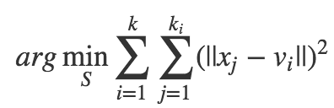
Introduction to K Means Clustering
Clustering algorithm used in data mining
Aims to partition N data points into K clusters
---->where, each data belongs to the cluster with nearest mean.
Objective Function
number of data points in cluster i
number of clusters
center/mean of cluster i

Slide 15
Parallelization: CUDA C Implementation
Step0: HOST initialize cluster centers, copy N data coordinates to DEVICE.
Step1: Copy data membership and k cluster centers from HOST to DEVICE.
Step2: In DEVICE, each thread process a single data point, compute the distance and update data membership.
Step3: Copy the new membership to HOST, and recompute cluster centers.
Step4: Check convergence, if not, go back to step1.
Step5: Host free the allocated memory at last.
Step2: In DEVICE, each thread process a single data point, compute the distance and update data membership.

